Slide 1



Smart Home Automation Systems for Assistive Technology
Results & Discussion Team 3

Slide 2

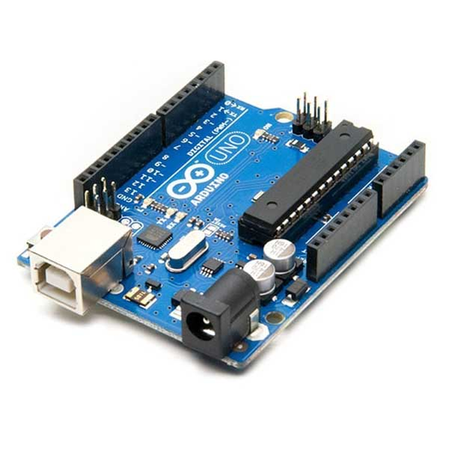
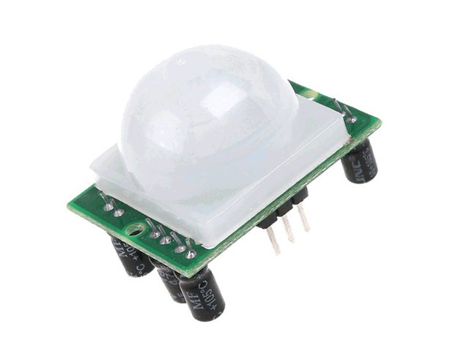
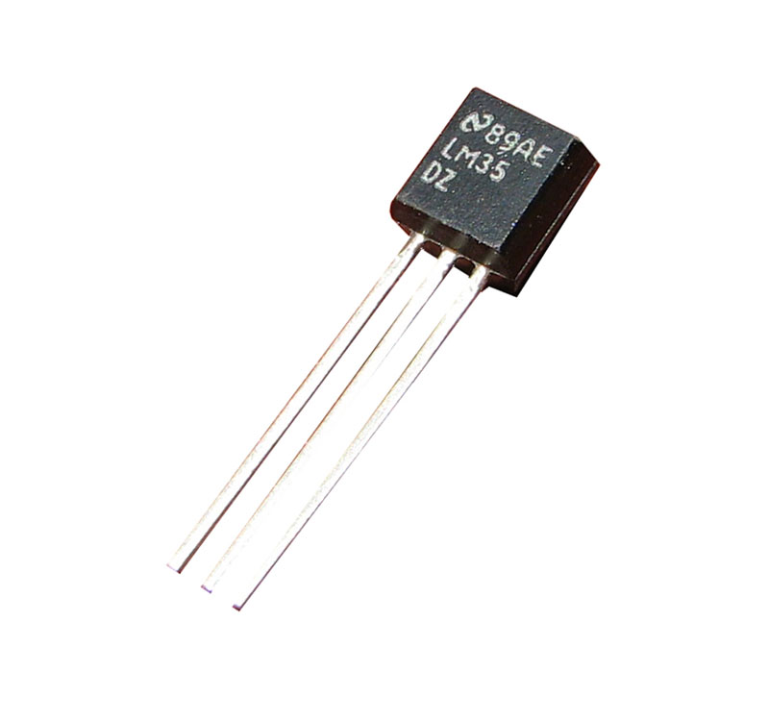
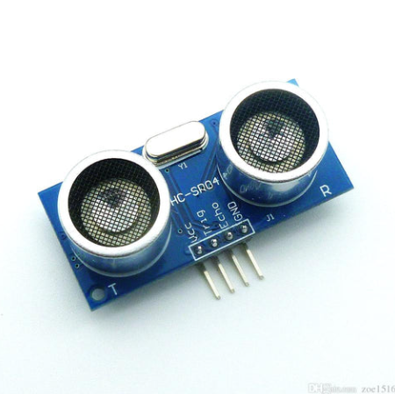
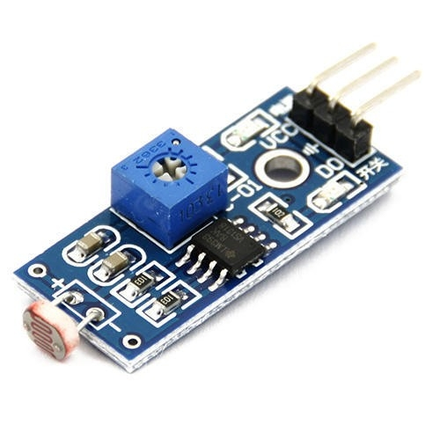
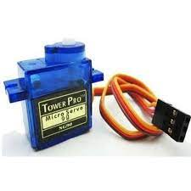
Components
Arduino Uno
PIR Motion Sensor
Temperature Sensor (LM35)
Ultrasound sensor
LDR (Light Dependent Resistor)
Servo Motors

Slide 3


PIR Motion Sensor
Reliable Movement Detection
Validation in Real-world Scenarios
3.

Slide 4
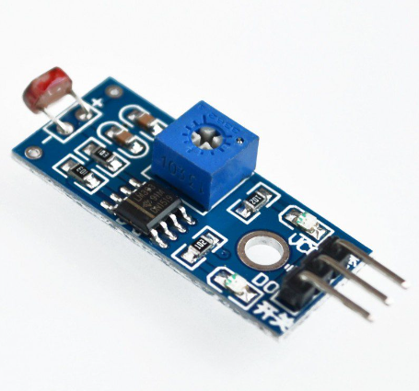
LDR (Light Dependent Resistor)
3.
Successful Detection of Ambient Light Variations
Role in Enhancing Security Features

Slide 5
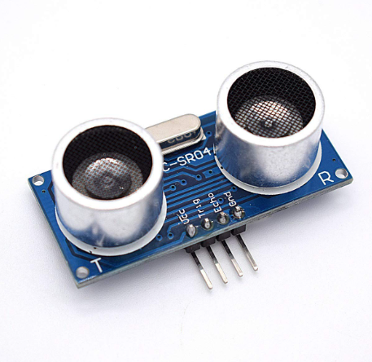


3.
Ultrasonic sensor
Reliable Distance Measurement
Improved Surrounding Lighting for User Proximity

Slide 6
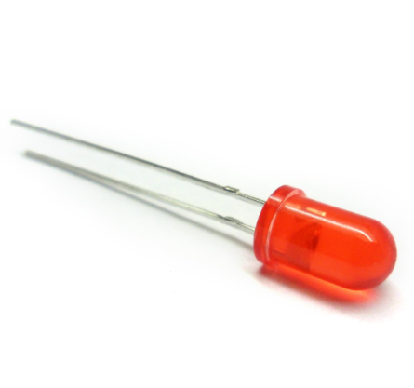
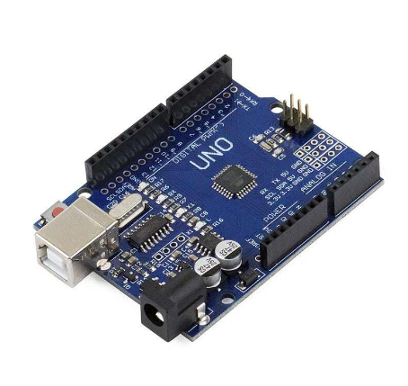
3.
+
LEDs and Arduino Uno
Effective Information Conveyance Through Visual Cues
Green LEDs for Motion, Red LEDs for Ultrasound Detection

Slide 7
Temperature Sensor (LM35)
3.
Accurate Temperature Readings
Valuable for Surroundings Monitoring

Slide 8
3.
Servo Motors
Collaboration with LDR for Controlled Door Movement
Swift and Precise Responses

Slide 9

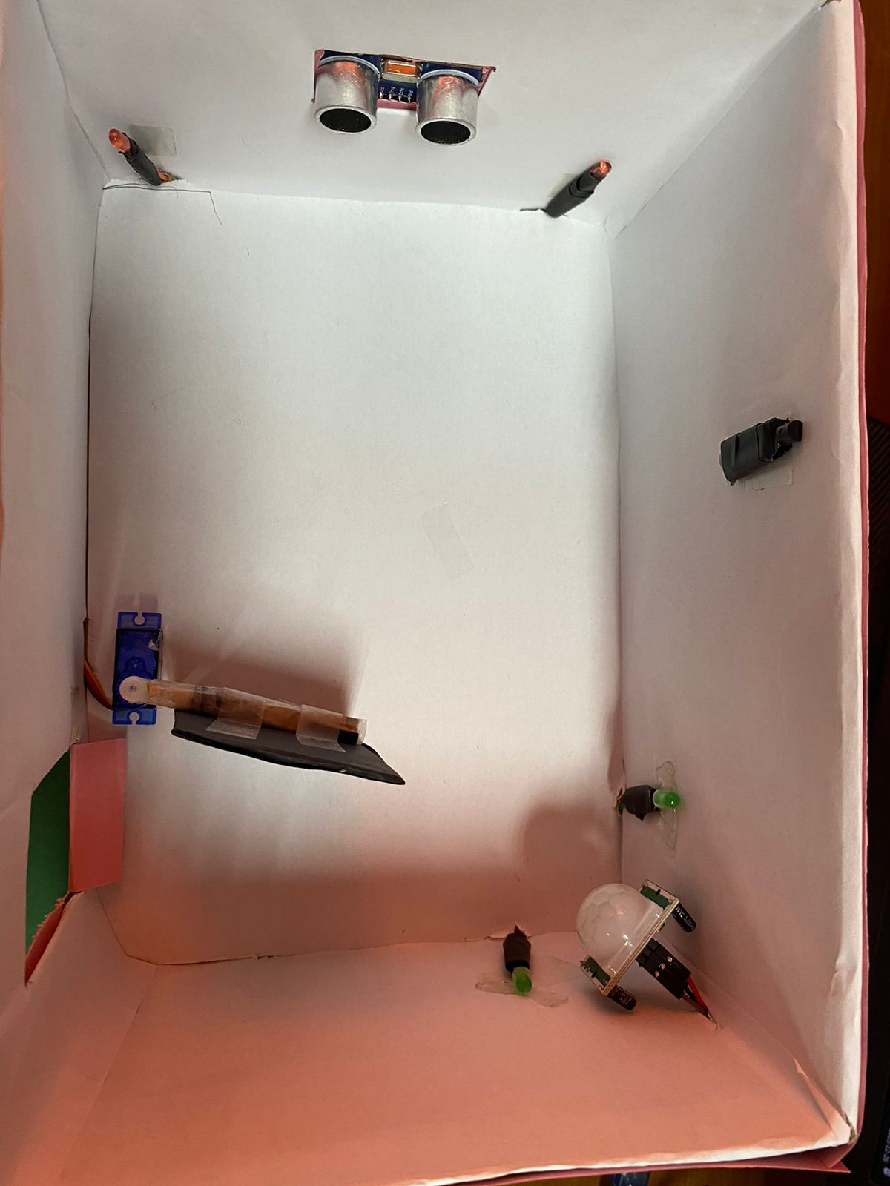
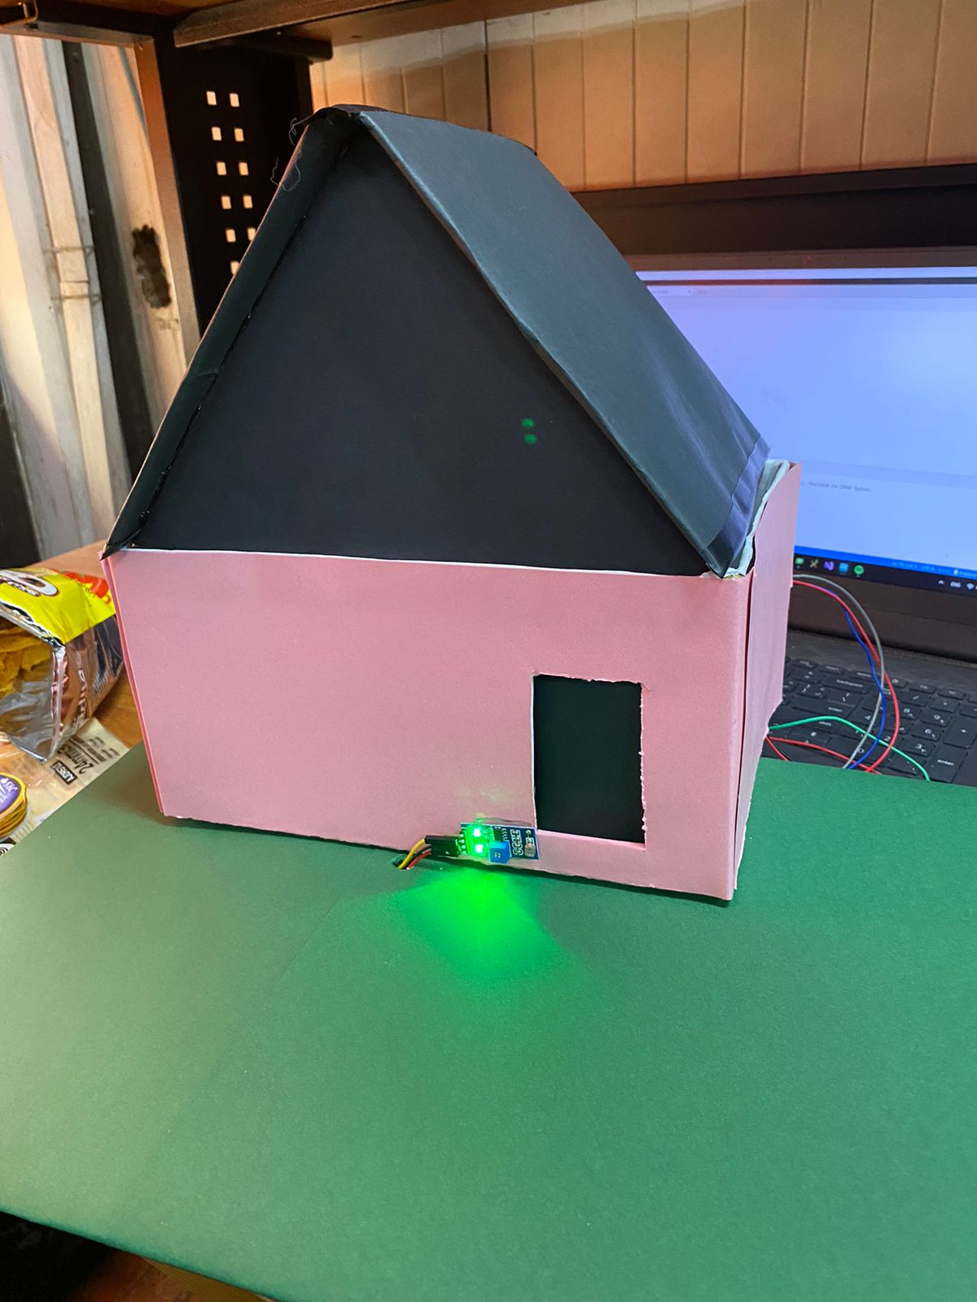
Conclusion
Smart Home Assistive Technology Achieves Goals
The successful combination of different parts shows that making a user-friendly, responsive, and clever smart home system is possible.

Slide 10
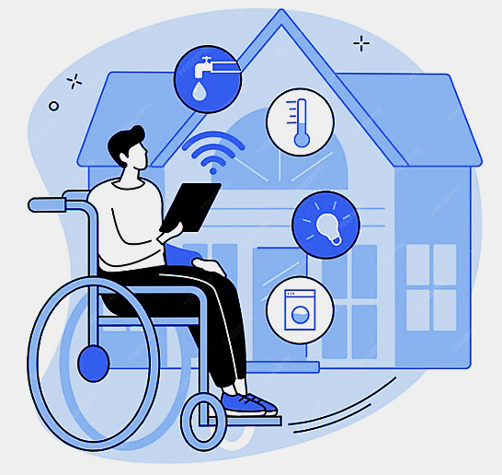
Future Work
Enhanced Security Features (Facial Recognition, Voice Authentication)
IoT Integration for Remote Monitoring
Energy Efficiency Measures
User-Friendly Interface Development
Expansion of Sensor Capabilities
Machine Learning Integration for Personalization

Slide 11


